Slide 1
Lake Tisza's attractions

Slide 2
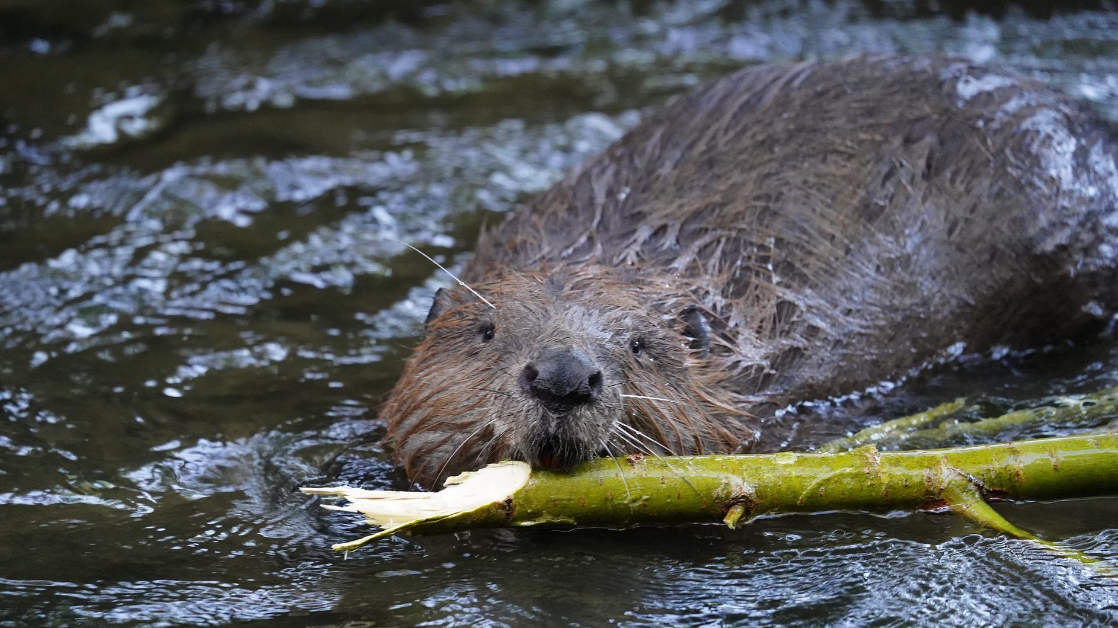
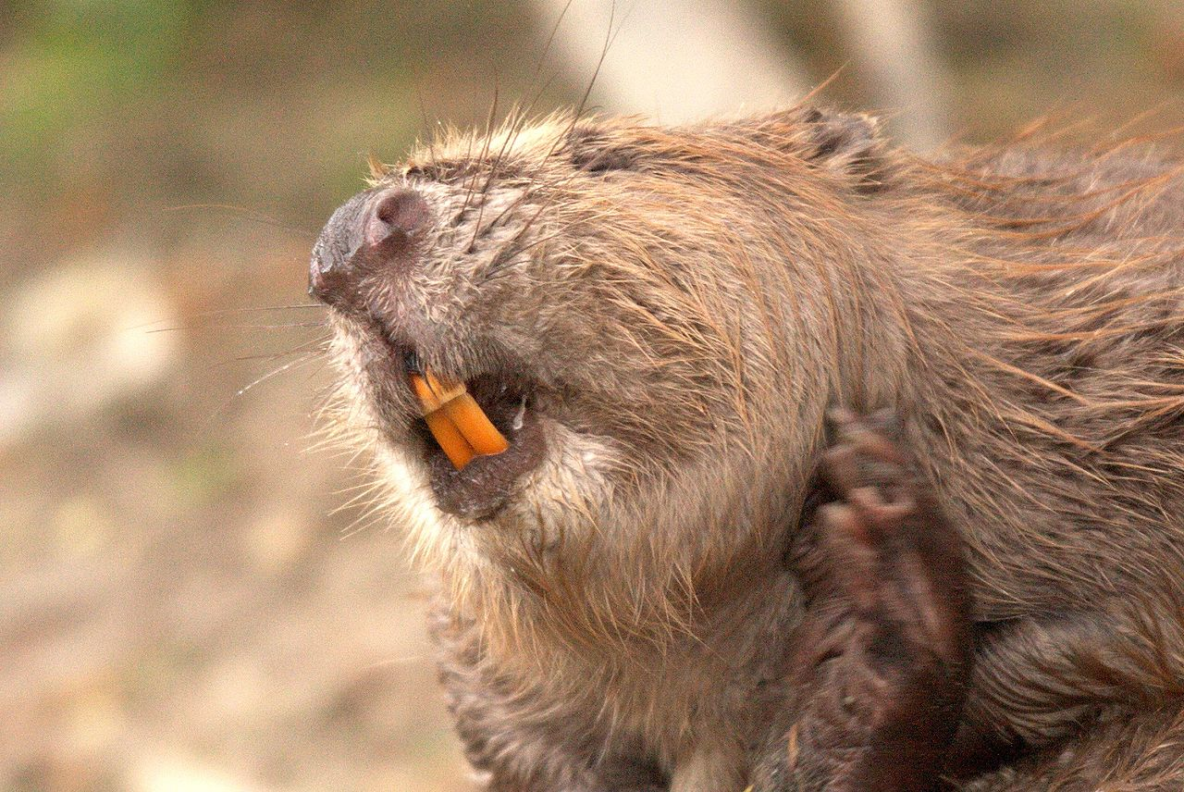
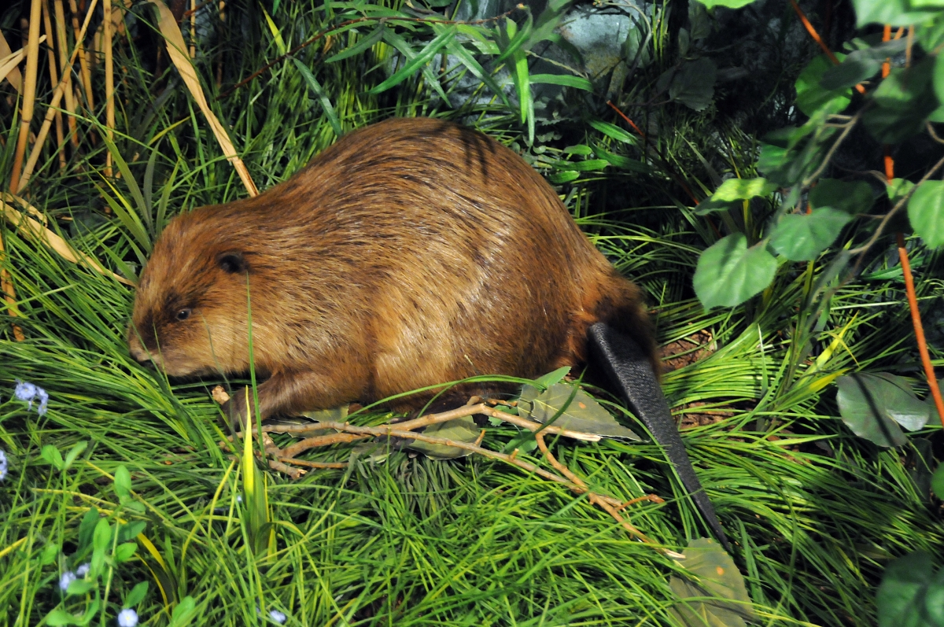
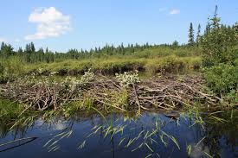
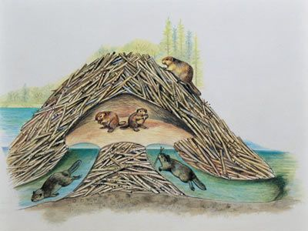
The beavers of Lake Tisza

Slide 3
The beavers of Lake Tisza
By the middle of the 19th century, they almost became extinct due to hunting. In 2005, 26 beavers got released on an island at Lake Tisza. Since then they have re-established themselves. Now they are very common around the Tisza Lake.
Beavers are known for building dams but they actually live in lodges. They build them out of twigs and branches. The entrance is usually underwater so they have to swim into them and their living space is inside.
Beavers are quite peaceful but if they feel threatened they can be really aggressive.

Slide 4
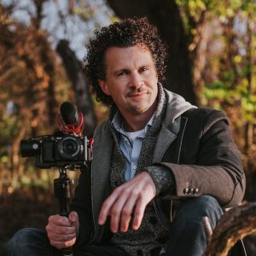
Ljasuk Dimitry
Ljasuk Dimitrij is a Hungarian-Ukranian independent filmmaker and enviormental activist.
He is mostly known for his films about Lake Tisza and his work as an enviormentalists.

Slide 5
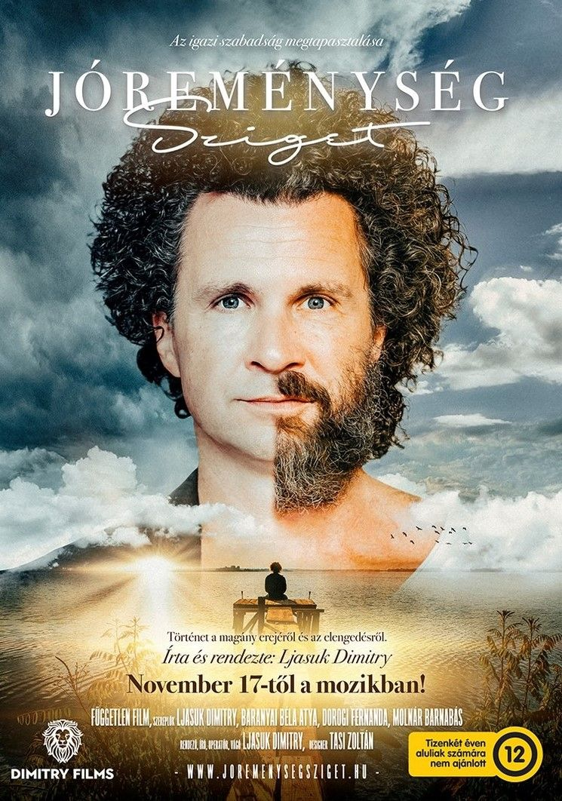
Island of good hope
Island of hope is an independent movie made by Ljasuk Dimitry that was released on the 17th of november in 2022.
The movie is based on the experiences and life of Ljasuk Dimitry
The movie deals with themes of loneliness, freedom and nature

Slide 6
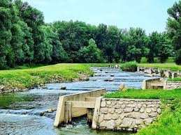
The fish ladder

Slide 7
The fish ladder: where the fishes swim against the flow
Its the largest ecological fish corridor in Central Europe
It was created in 2014 so fish can freely and naturally move between the lake and the river
The fish ladder is located in Kisköre.
It connects Lake Tisza and River Tisza
The fish corridor runs to River Tisza for a distance of nearly 1400 meters

Slide 8
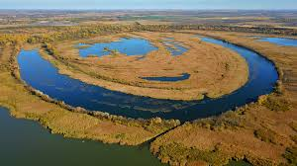
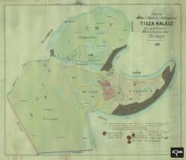

Island Óhalász: the village that was ruined by an icy flood

Slide 9
Island Óhalász: the village that was ruined by an icy flood
Óhalász is an island located on the River Tisza
It used to have a small village called Tiszahalász
In 1876 a terrible icy flood hit the town
It was flooded completely
There are only a few bricks and remains of buildings that remind us of its existence

Slide 10
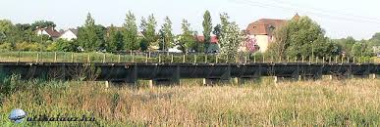
The hanging canal in Tiszaörvény

Slide 11
The hanging canal in Tiszaörvény
It was put into operation by Governor Miklós Horthy on June 20th in 1940.
It was needed because in 1934 an 1935 a really bad drought hit the Alföld and a lot of land dried up.
It has been used for over 80 years at this point.
Its the only one of its kind in Hungary

Slide 12
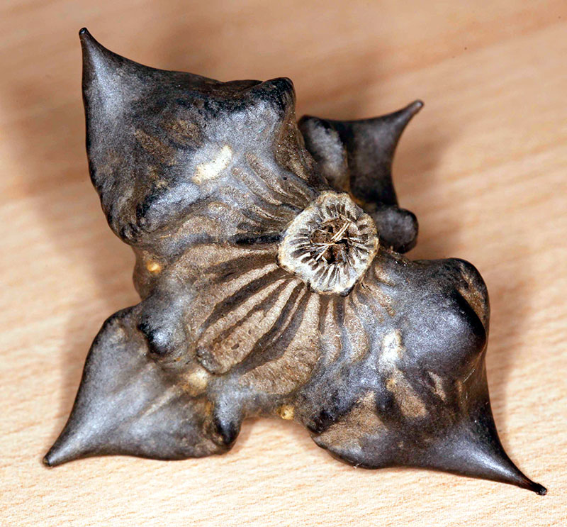
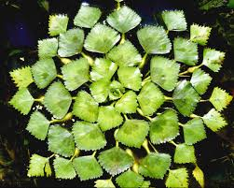
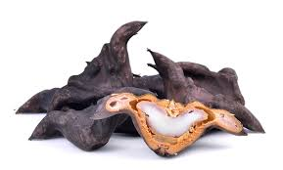
Sulyom and foods made form it

Slide 13
Sulyom and foods made form it
Sulyom is very common around Lake Tisza.
Altough it has large and sharp spikes, it’s actually edible.
It’s usally cooked in boiling water.
People often compare it to chestnut

Slide 14
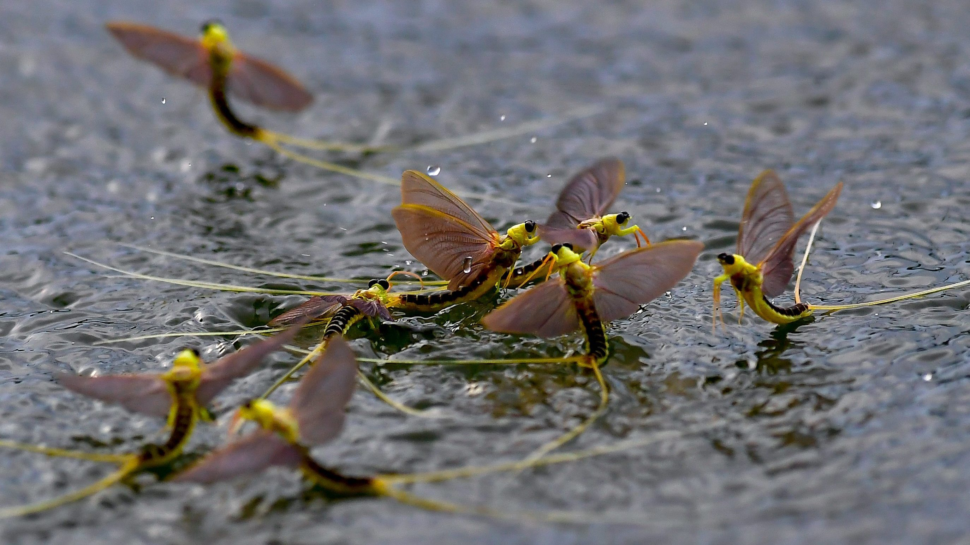
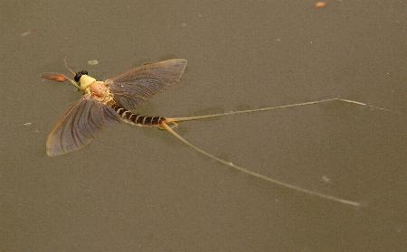
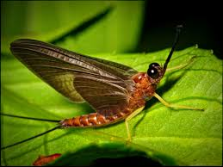
Mayfly dance: why are mayflies so unique

Slide 15
Mayfly dance: why are mayflies so unique
The flower of Tisza despite its name is not a flower. It’s actually mayflies.
This type of mayfly lives a very short life.
They spend 3 years of their life as a larva
Once a year they come out of the water and they change into their fully grown form.
They can't enjoy it for long though because they only live about 5-10 minutes in their fully grown form.

Slide 16
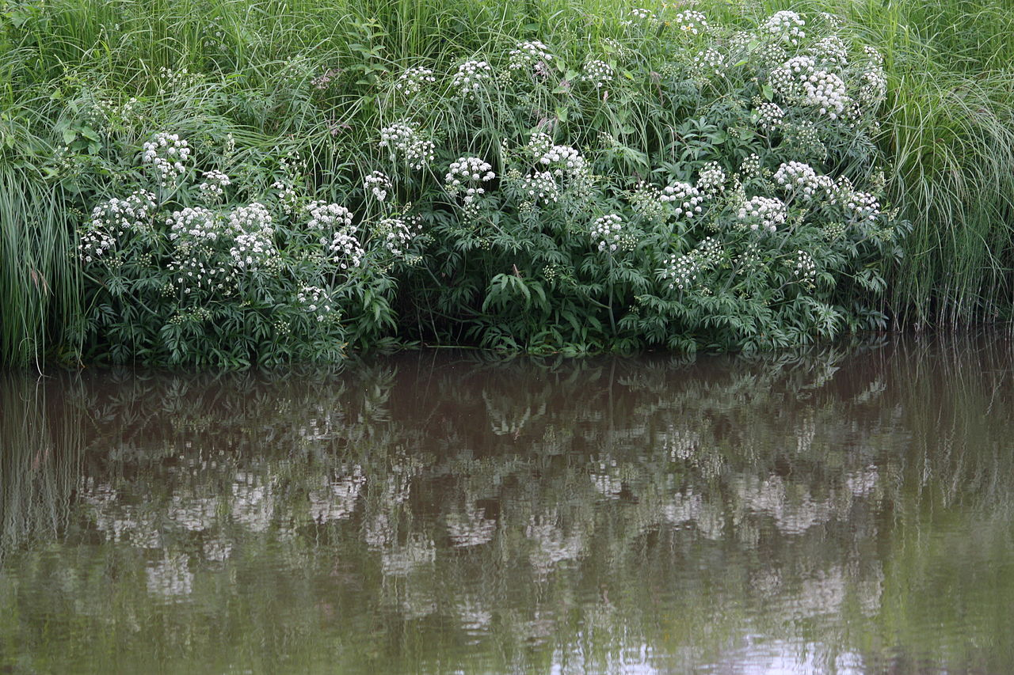
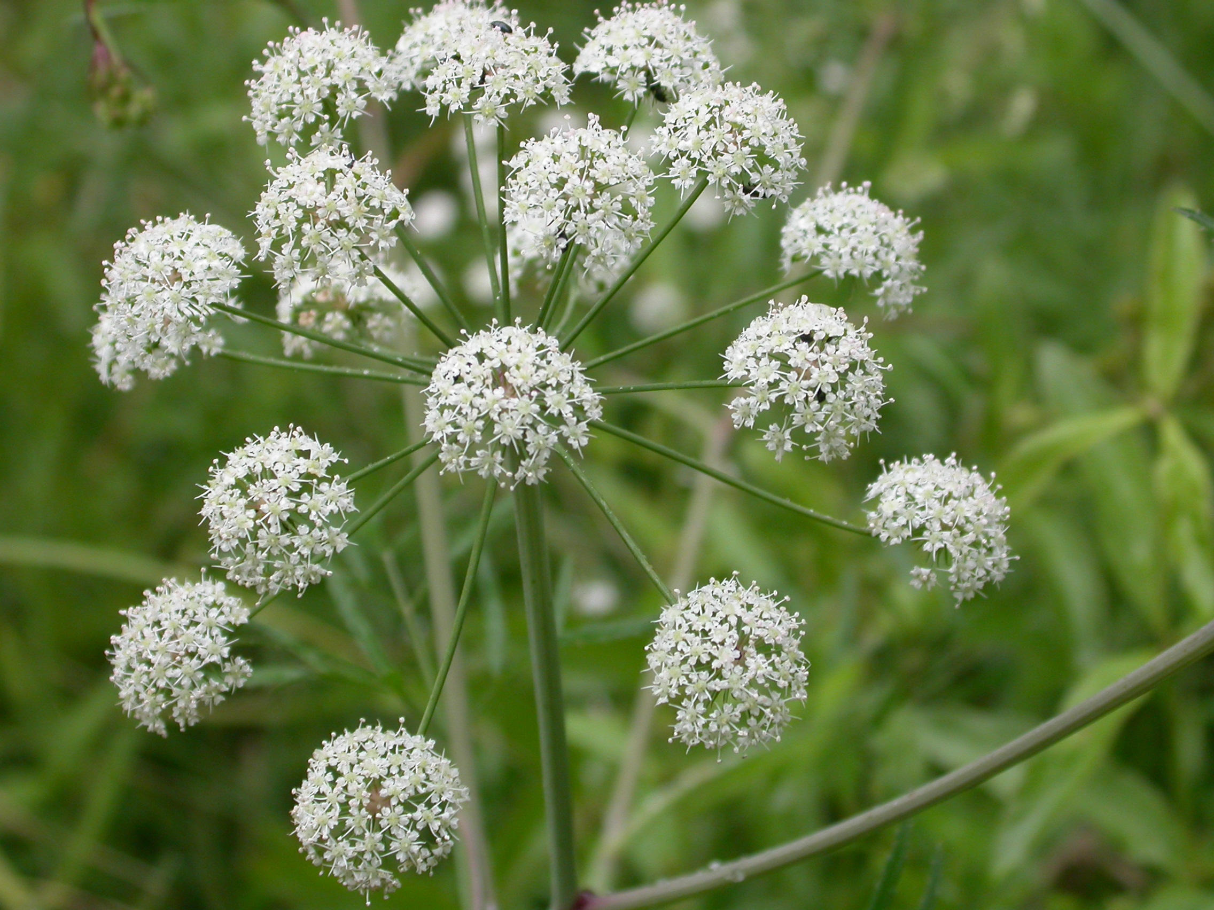
The gyilkos csomorika: a very poisonous plant

Slide 17
The gyilkos csomorika: a very poisonous plant
Although their plants may look pretty at first they are called gyilkos(killer) csomorika for a reason
It’s regarded as one of the most poisonous plants.
All of its parts are poisonous especially rhizome

Slide 18
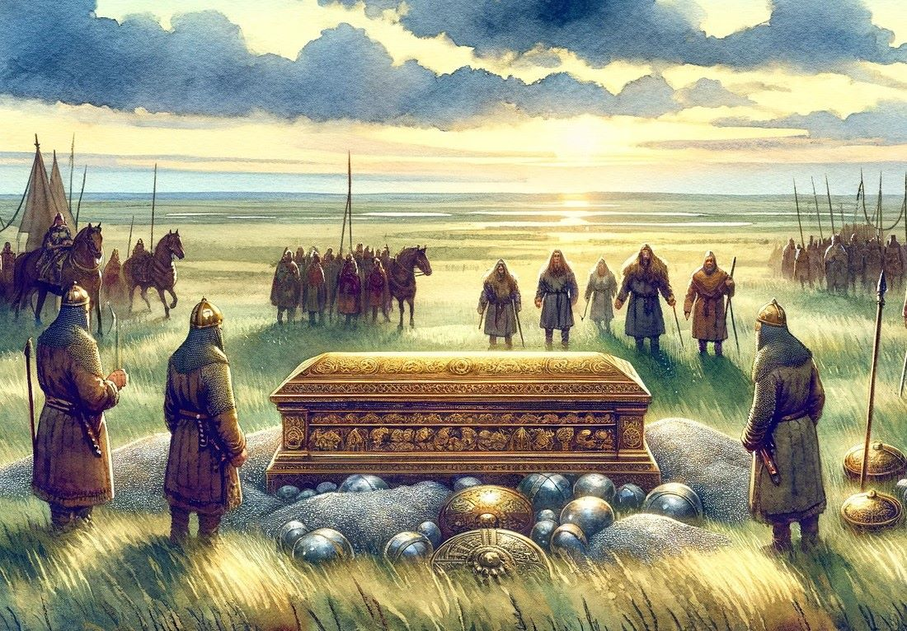
The grave of King Attila

Slide 19
The grave of King Attila
King Attila often called the King of the Huns was the ruler of the huns from 434 to his death.
When he died he was said to have got burried in the bed of River Tisza
They said to have bound his coffins. The first in gold, the second with silver and the third one in gold.

Slide 20
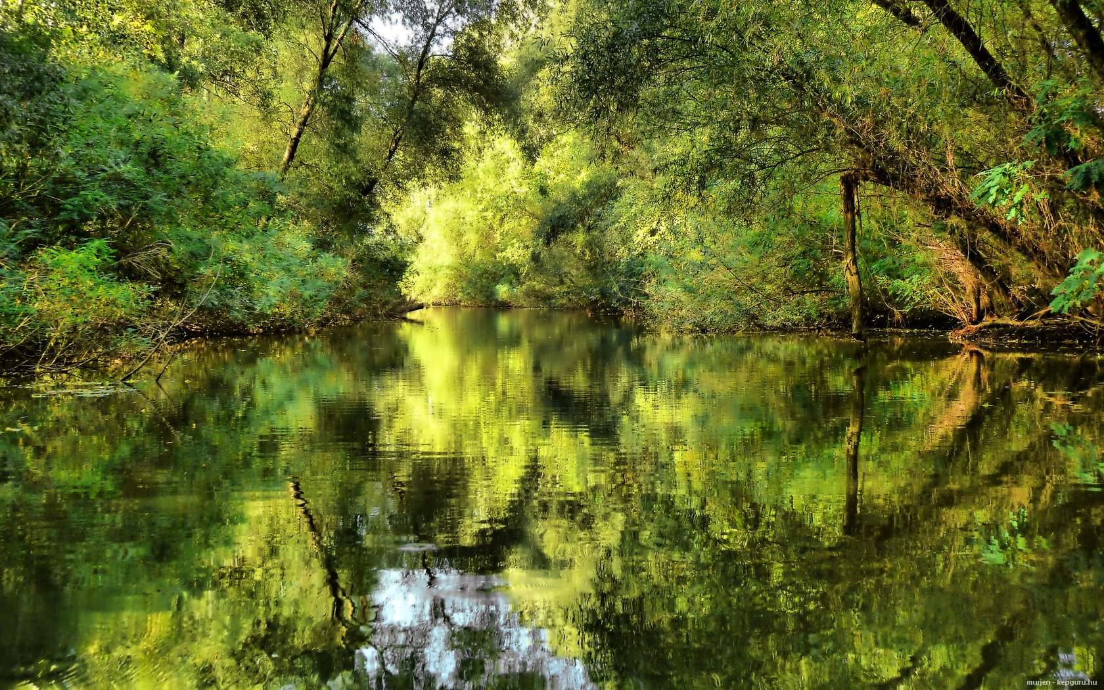
The "blonde" Tisza

Slide 21
The "blonde" Tisza
The blonde Tisza is a name many use to refer to The lake Tisza but where did this mame come from?
When we say blonde we refer to the light browm colour the water is.
The light brown colour is caused by all the sand and mud floating in the lake.

